Slide 1
ASSESSMENT OF HALDA RIVER IN CONTEXT OF SURFACE WATER CHANGES AND LAND USE AND LAND COVER IN ITS BASIN BY GOOGLE EARTH ENGINE
Presented by: Sourav Karmakar
Environmental Science, University of Chittagong

Slide 2
Introduction
Halda River:
A natural fish spawning heritage of Bangladesh
Major water source for Chittagong City
Industrial and agricultural activity
Anthropogenic degradation

Slide 3
Rationale
Halda – a dynamic river, continuously shifting its course
Erosion and accretion over Halda
Measuring Erosion and accretion is challenging
Global Surface Water database
This study aims to measure erosion and accretion from GSW database

Slide 4
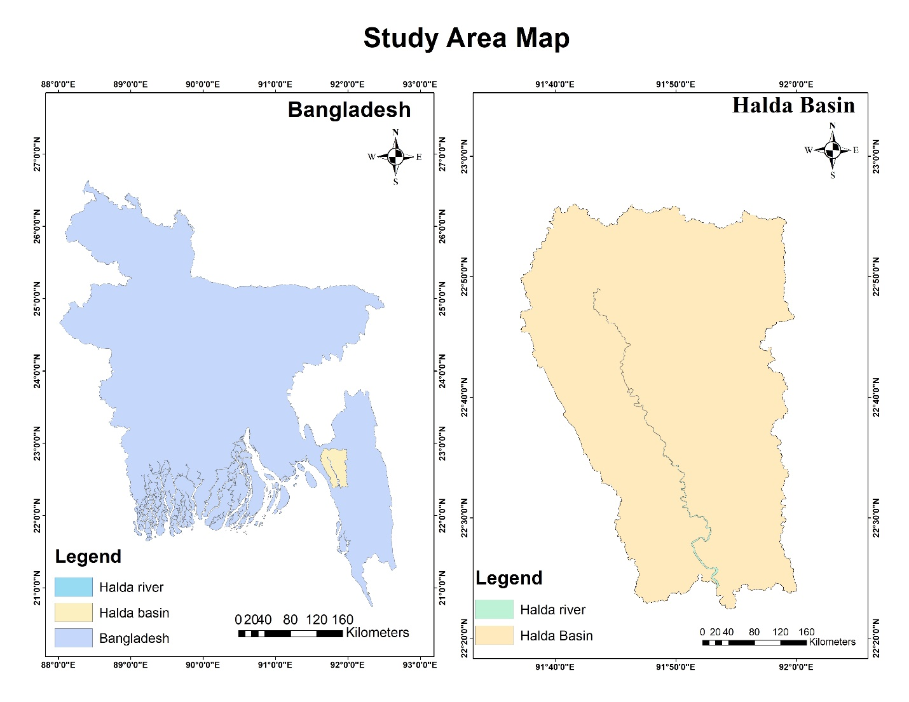
Study Area

Slide 5
Objectives
Estimation of river bank erosion and accretion by quantifying river surface water transition between 1984 and 2015.
Mapping river course changes of Halda river over 2001 – 2018 to capture the recent trend of river.
Land use and land cover classification along with NDWI based surface water classification to count the water covered area of starting and ending year and contextualize it to the river course changes

Slide 6
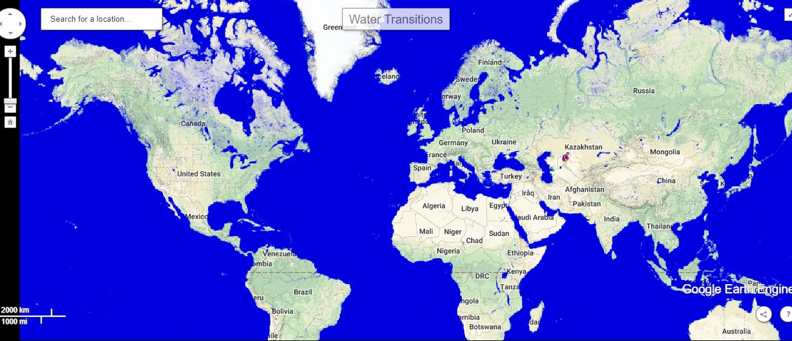
Methodology
JRC Database (https://global-surface-water.appspot.com/)

Slide 7
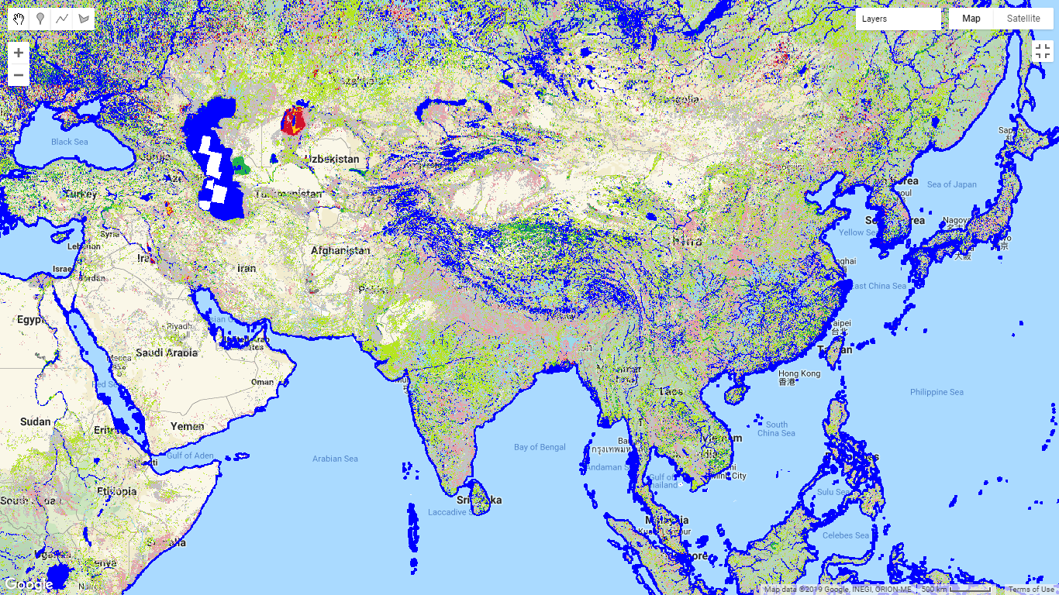
Water transition class
Source: https://global-surface-water.appspot.com/map

Slide 8
Methodology
Open GEE code editor
Add map layer
(Visualize transition classes)
Summarizing Area
(clip to region)
Download summary chart
Create summary chart
to calculate area
Surface water mapping in Earth Engine

Slide 9
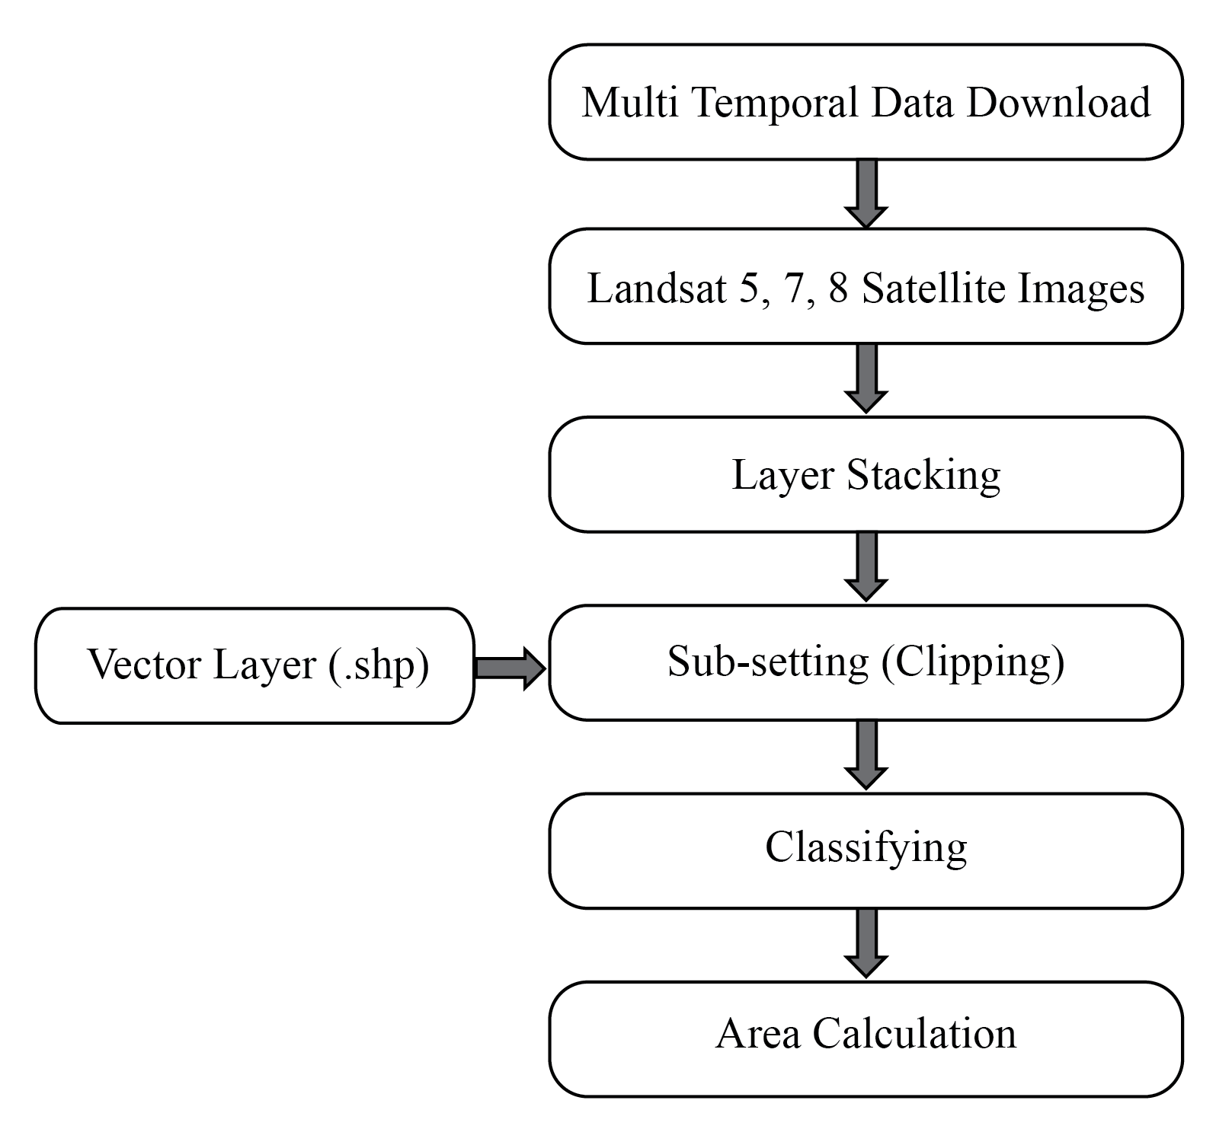
Methodology
Land use classification in ArcMap 10.5 and ERDAS IMAGINE 2015

Slide 10
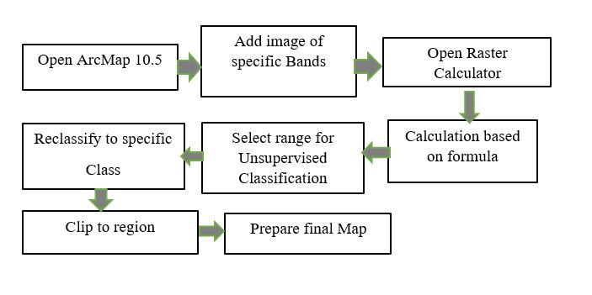
Methodology
NDWI classification in ArcMap 10.5

Slide 11
Result and Discussion
LULC classification
NDWI based Classification
Water transition change
River course change

Slide 12
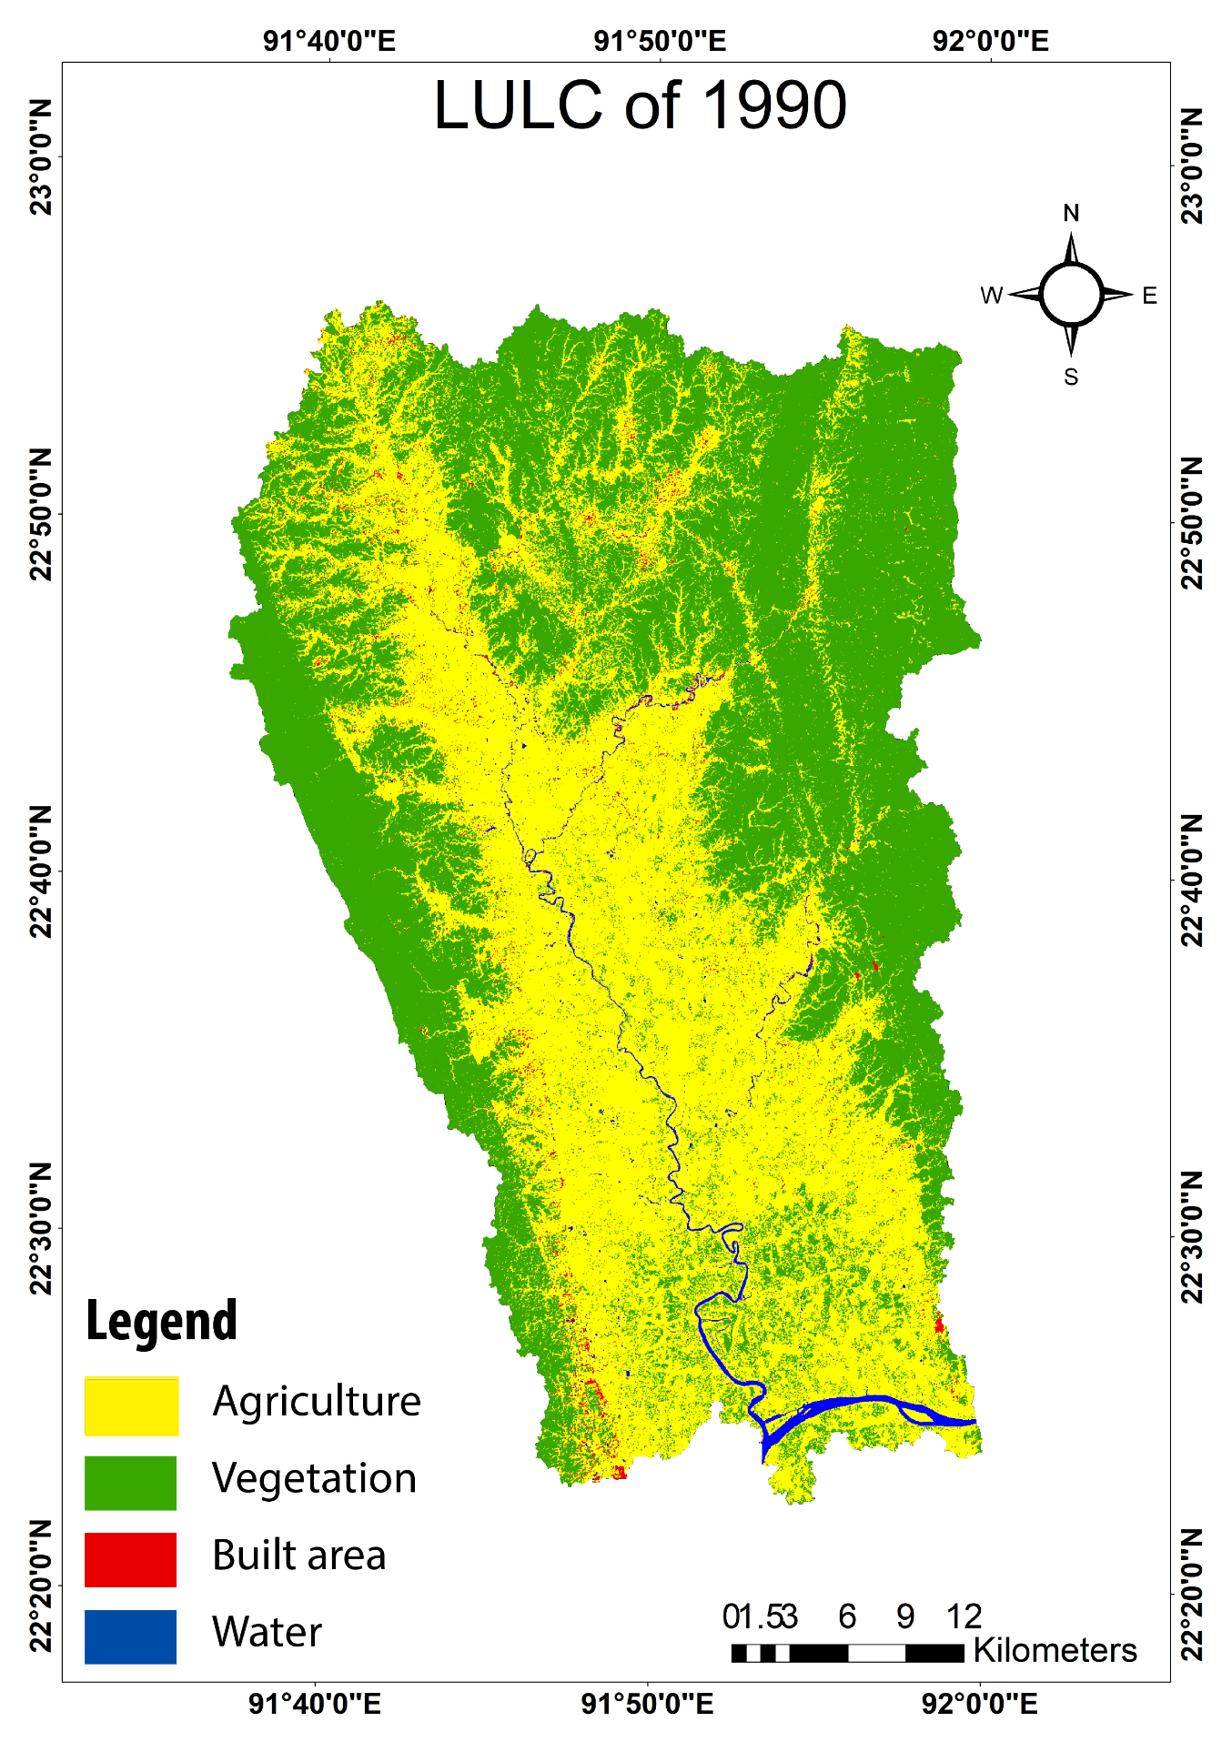
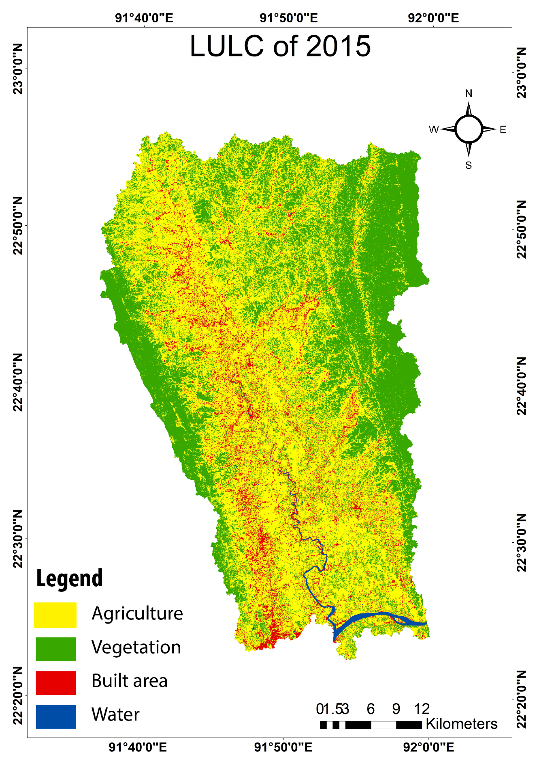
LULC classification

Slide 13
LULC change
Land Use Category | Land Use Change: 2015-1990
 | Changed Area 1977-1997 (Ha) | % Change | Annual rate of change (Ha)
Agriculture | 7653.67 | 9.17 | 306.15
Vegetation | -17634.15 | -20.73 | -705.37
Built area | 10499.22 | 564.71 | 419.97
Water Body | -518.74 | -26.45 | -20.75

Slide 14
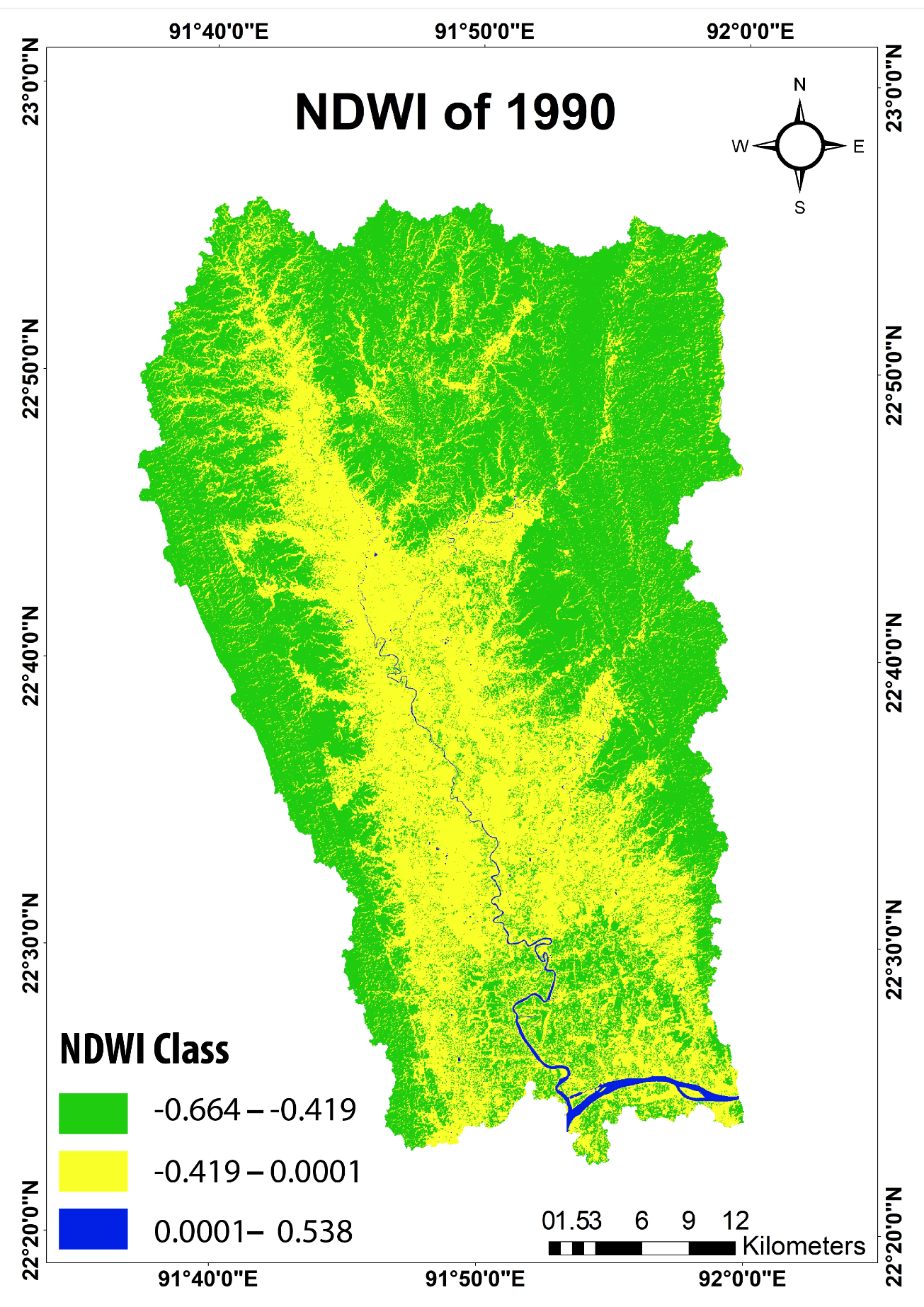
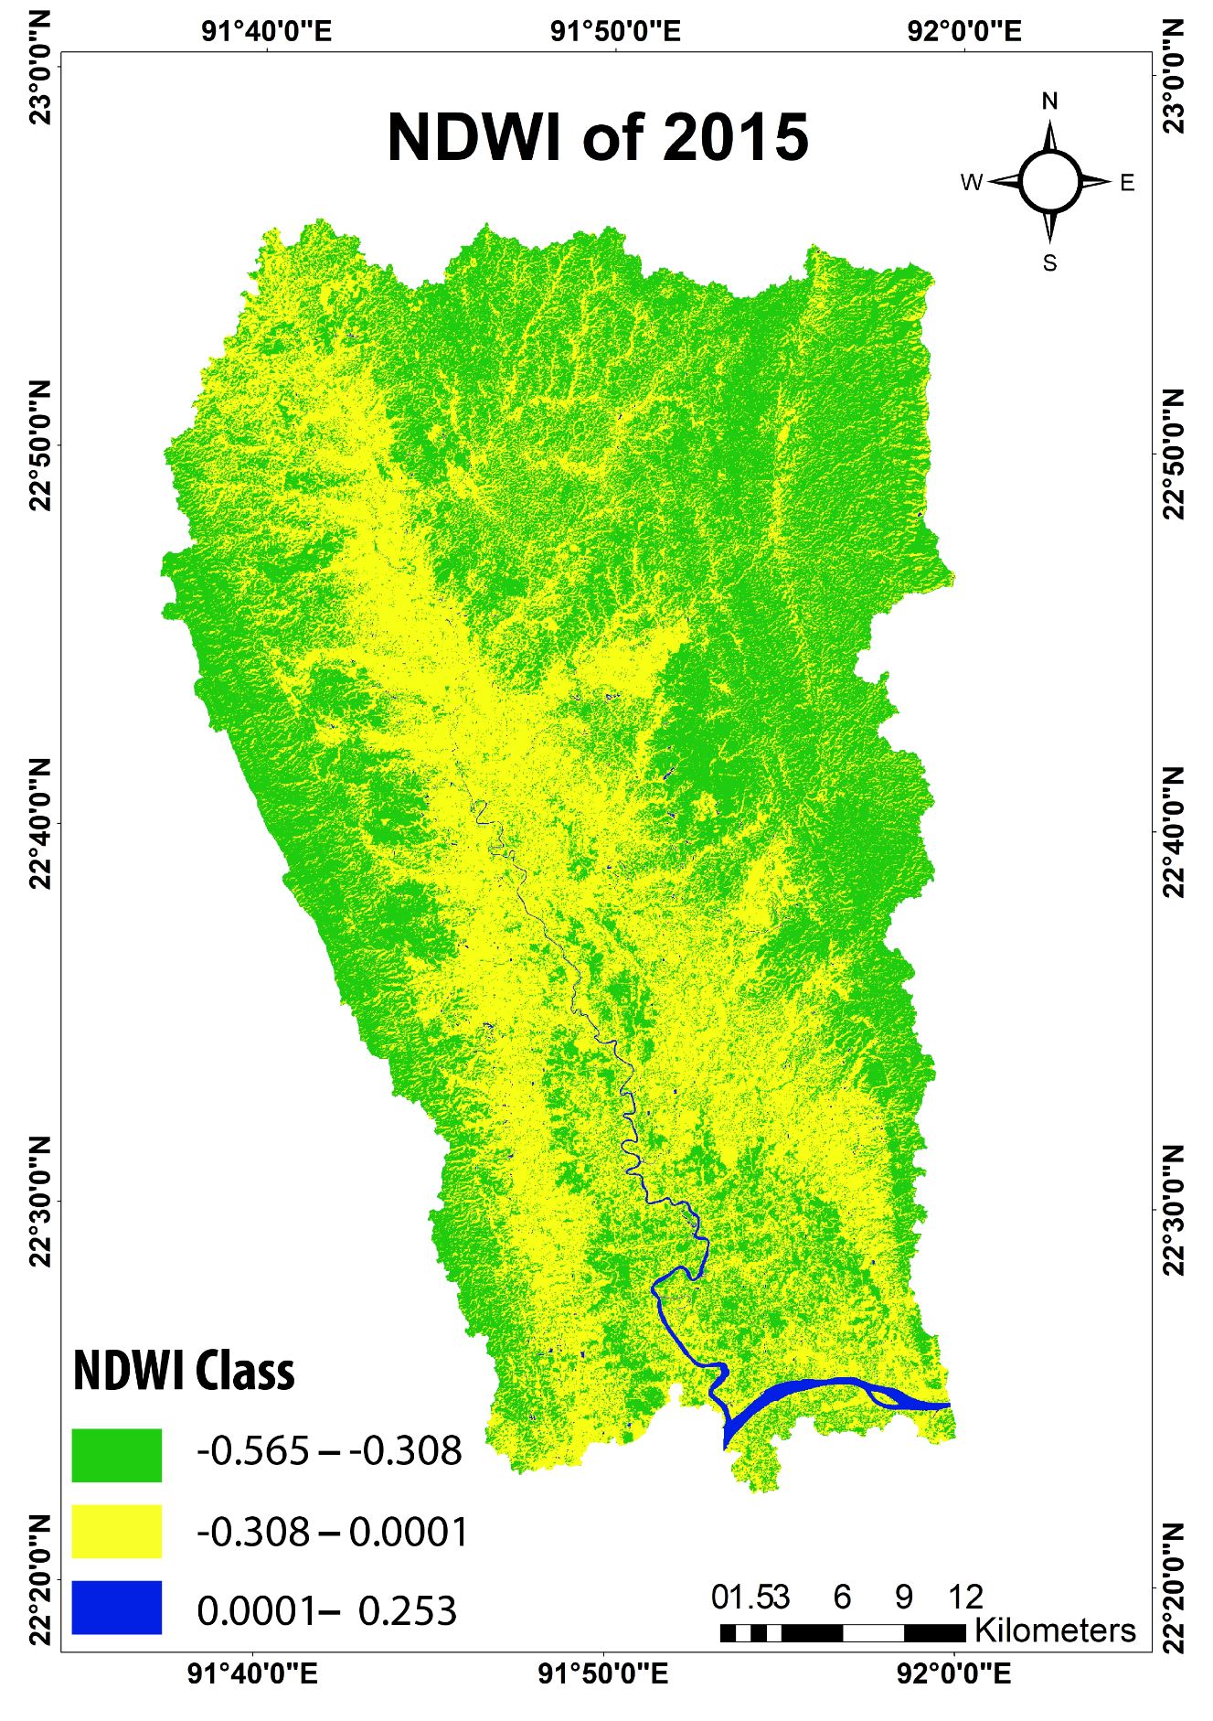
NDWI classification
NDWI = (Green – NIR) / (Green + NIR)
1990_NDWI = (B2 – B4) / (B2 + B4)
2015_NDWI = (B3 – B5) / (B3 + B5)
Waterbody reduced by 182.28 ha

Slide 15
Area with transition classes
Name of transition class | Area (ha) in Basin | % | Area (ha) in River | %
Permanent | 756.91 | 33.71 | 228.25 | 33.69
New permanent | 64.6 | 2.88 | 22.27 | 3.29
Lost permanent | 16.8 | 0.75 | 16.39 | 2.42
Seasonal | 141 | 6.28 | 84.79 | 12.51
New seasonal | 333.69 | 14.86 | 95.52 | 14.10
Lost seasonal | 270.74 | 12.06 | 146.63 | 21.64
Seasonal to permanent | 29.39 | 1.31 | 12.58 | 1.86
Permanent to seasonal | 7.28 | 0.32 | 4.09 | 0.60
Ephemeral permanent | 2.81 | 0.13 | 2.73 | 0.40
Ephemeral seasonal | 622.05 | 27.70 | 64.25 | 9.48
Erosion = 117.79 ha
Accretion = 163.02 ha

Slide 16
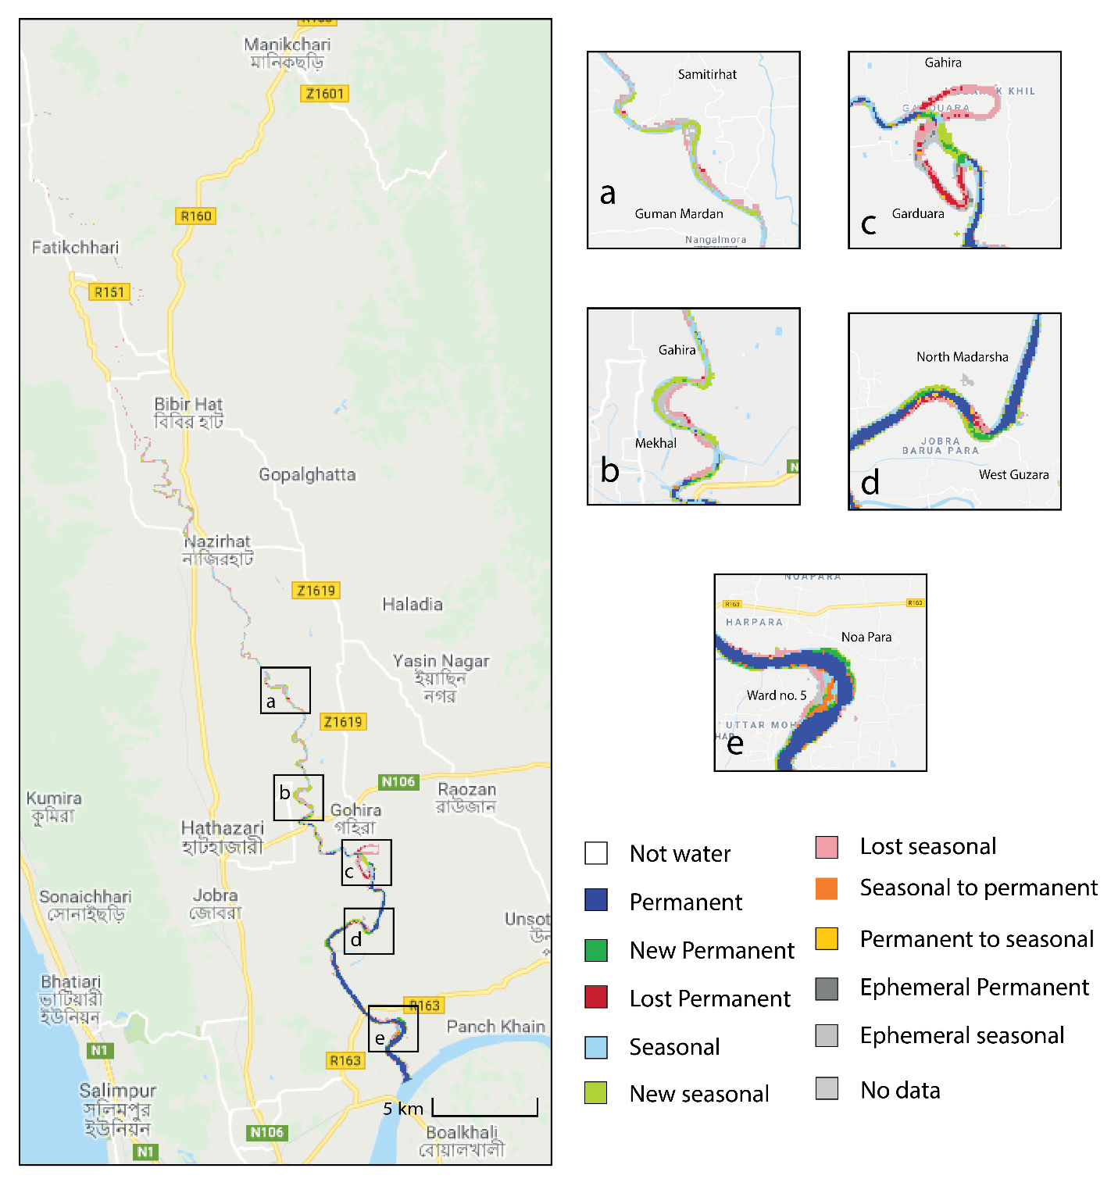
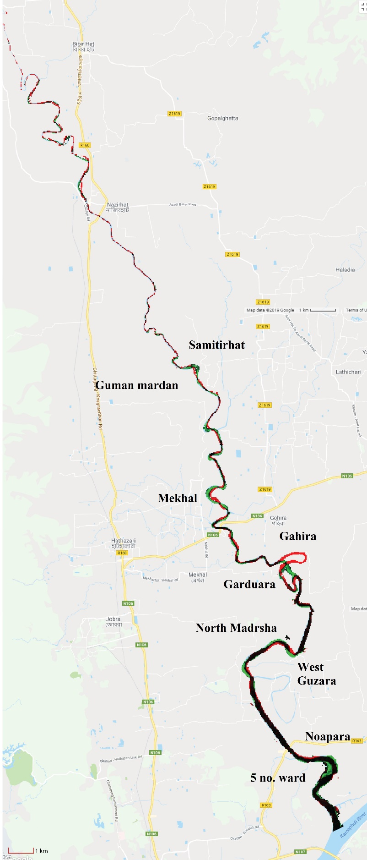
Water Transition Change over Halda river
Narayanhat
Bhujpur
Suabil
Samitirhat
Garduara
Occurrence Change Intensity

Slide 17
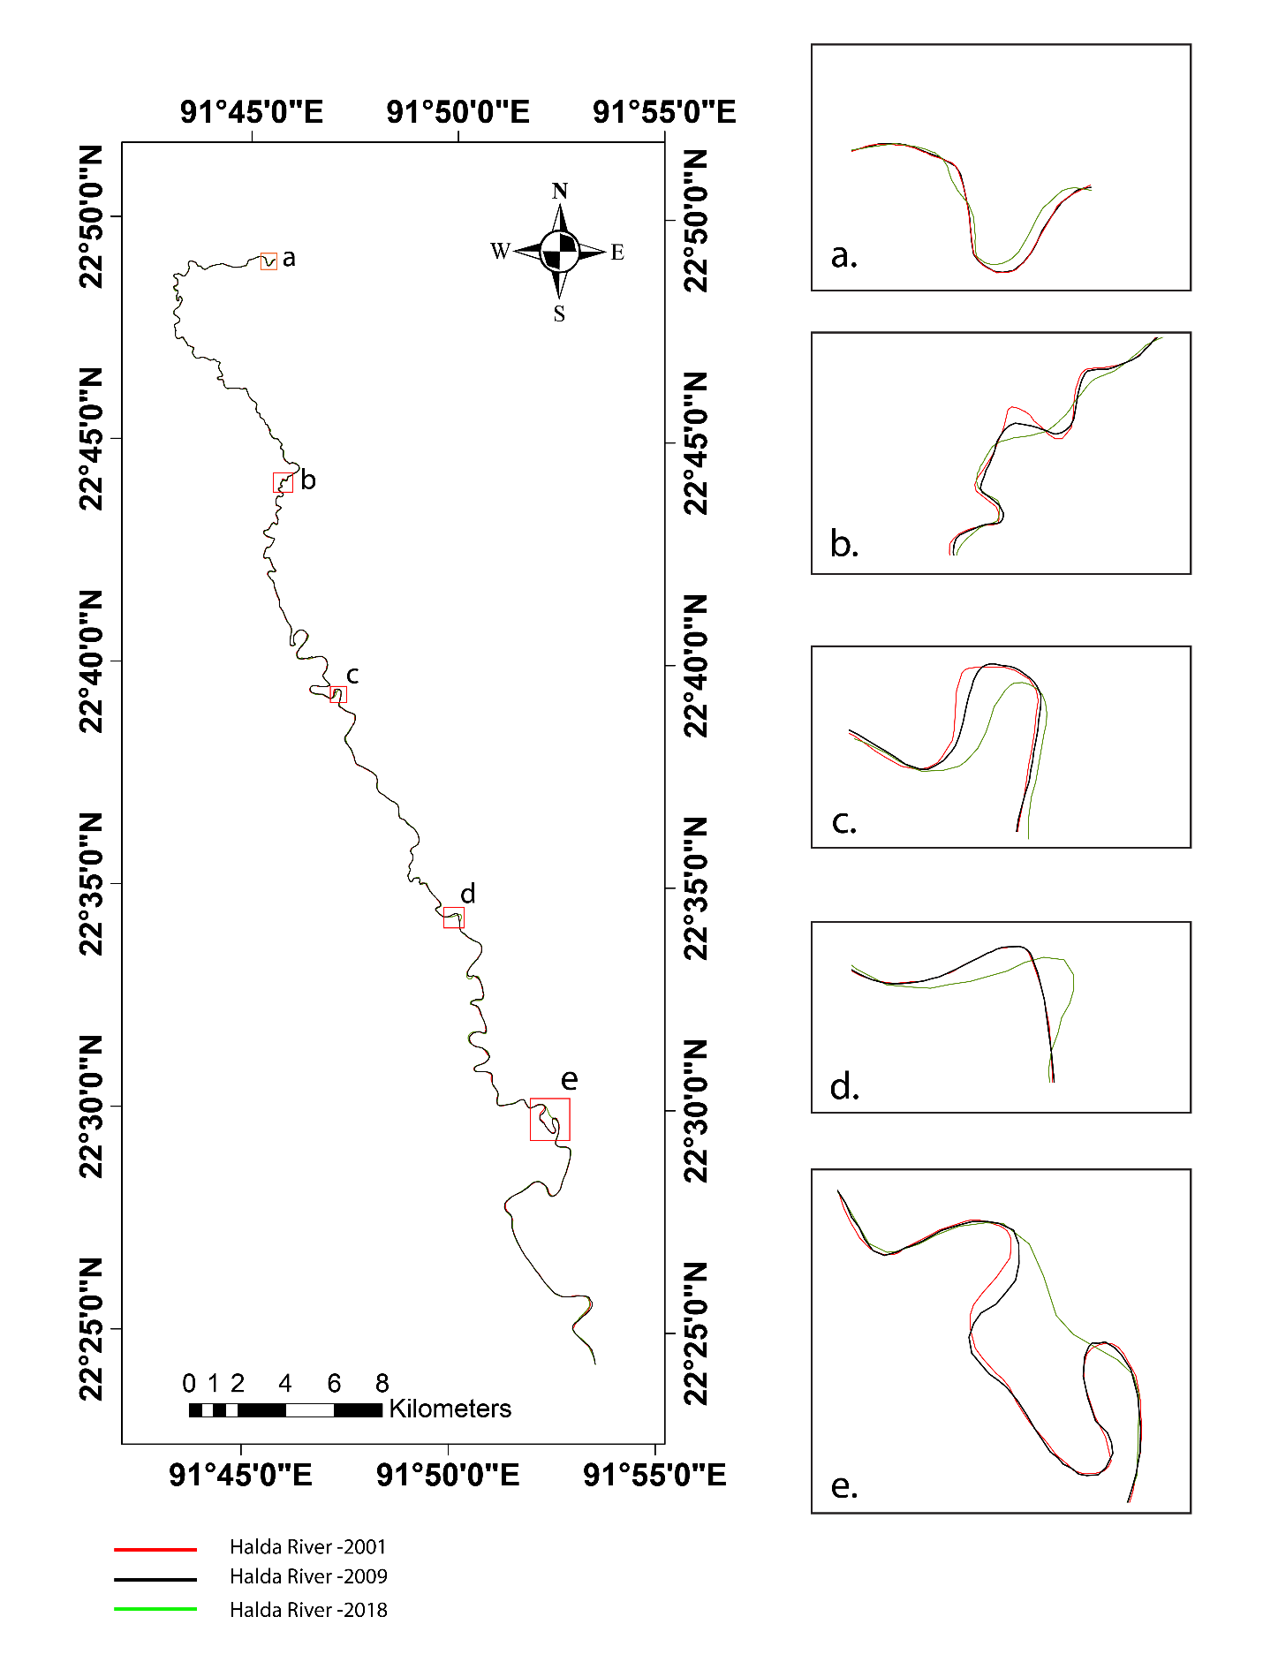
River Course Change
Narayanhat
Bhujpur
Suabil
Samitirhat
Garduara

Slide 18
Change in river width
Point no. | Width in 2001 (m) | Width in 2009 (m) | Width in 2001 (m) | Change in 2009-2001 | Change in 2018-2009 | Change in 2018-2001
A | 304 | 303 | 319 | -1 | 16 | 15
B | 170 | 172 | 188 | 2 | 16 | 18
C | 149 | 147 | 154 | -2 | 7 | 5
D | 121 | 114 | 131 | -7 | 17 | 10
E | 101 | 93 | 131 | -8 | 38 | 30
F | 88.4 | 75 | 111 | -13.4 | 36 | 22.6
G | 52.6 | 40 | 110 | -12.6 | 70 | 57.4
H | 52.7 | 48.8 | 74.4 | -3.9 | 25.6 | 21.7
I | 56.3 | 48.3 | 67 | -8 | 18.7 | 10.7
J | 53.1 | 45.4 | 88.1 | -7.7 | 42.7 | 35
K | 32 | 44.1 | 121 | 12.1 | 76.9 | 89
L | 43 | 38.2 | 39.2 | -4.8 | 1 | -3.8
M | 39.2 | 34 | 30.4 | -5.2 | -3.6 | -8.8
N | 37.6 | 35.5 | 31.7 | -2.1 | -3.8 | -5.9
O | 32.2 | 44.9 | 17.1 | 12.7 | -27.8 | -15.1
P | 25 | 24.9 | 15.7 | -0.1 | -9.2 | -9.3
Q | 35.7 | 34.7 | 47.5 | -1 | 12.8 | 11.8
R | 28.7 | 31.7 | 31.2 | 3 | -0.5 | 2.5
S | 24.01 | 28.4 | 28 | 4.39 | -0.4 | 3.99
T | 23.2 | 32.8 | 30 | 9.6 | -2.8 | 6.8
K = Najirhat
O = Kumarpara

Slide 19
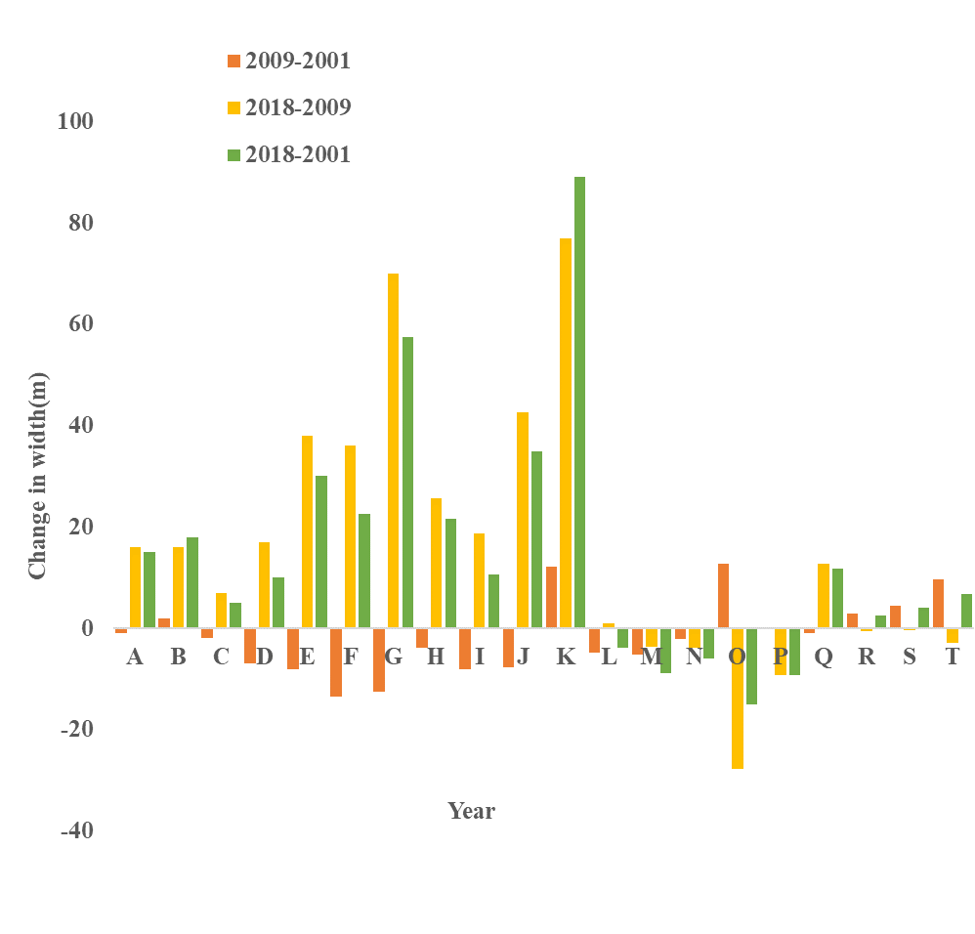
Fluctuation of parameters
Length:
2001: 81km
2009: 82km
2018: 80.8km
Bends:
2001: 29
2009: 29
2018: 26

Slide 20
Conclusion
Decreasing amount of water from LU and NDWI
Increase in built area and agricultural land leading to higher sediment flow which may explain the reduction in NDWI
Decreased width in rubber dam downstream
Upstream vegetation cover decreased resulting in high sediment flow

Slide 21
Recommendations
Plantation is crucial at Halda watershed
Remove rubber dam from upstream
Step should be taken at most vulnerable sites

Slide 22
Limitations of the study
No data at some places
Low quality satellite imagery
Data gaps due to cloud cover and atmospheric events
Time constraints

Slide 23


